Slide 1
CyberSentinel
Sprint 3 By Team Tech Titans

Slide 2
Agenda
01
02
03
Team & Planning
User & Product Definition
Technology & Implementation
04
05
06
Tracking & Evaluation
Demonstrations & Resources
Project Documentation & Management
Team Roles & Responsibilities
Improvements Based on Professor Feedback
Project Description
Team Working Agreement
Personas
Minimum Viable Product (MVP)
Technologies
Algorithms
Metrics & Progress Tracking
Sprint 3 Retrospective
Project Demo - Sprint 3
GitHub Repository Link
Live Application Demo
Sprint 2 Recap
Diagrams
Product Backlog
Sprint 3 Backlog

Slide 3
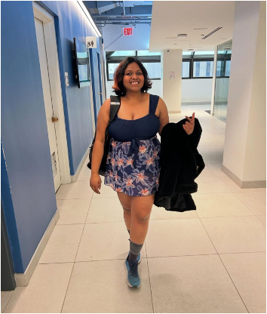


Team Members
Vaishnavi Dasari
Snehitha Bodiga
Aasritha Bhimisetty
Machine learning Engineer
Full Stack Developer
Frontend Developer

Slide 4



Team Members
Abisainath
Shoib Khan Patan
Dhanush Kolapalli
Backend Developer
Backend Developer
Machine Learning Engineer

Slide 5

Team Members
Neelkamal Rana
Full Stack Developer

Slide 6
Improvements
Excel burndown chart
Correct format for user stories
Recap

Slide 7
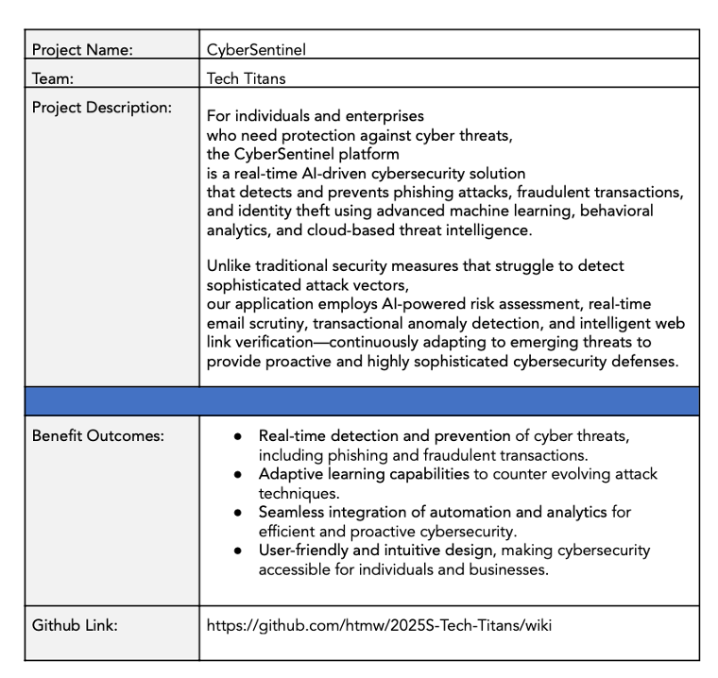


Project Description

Slide 8
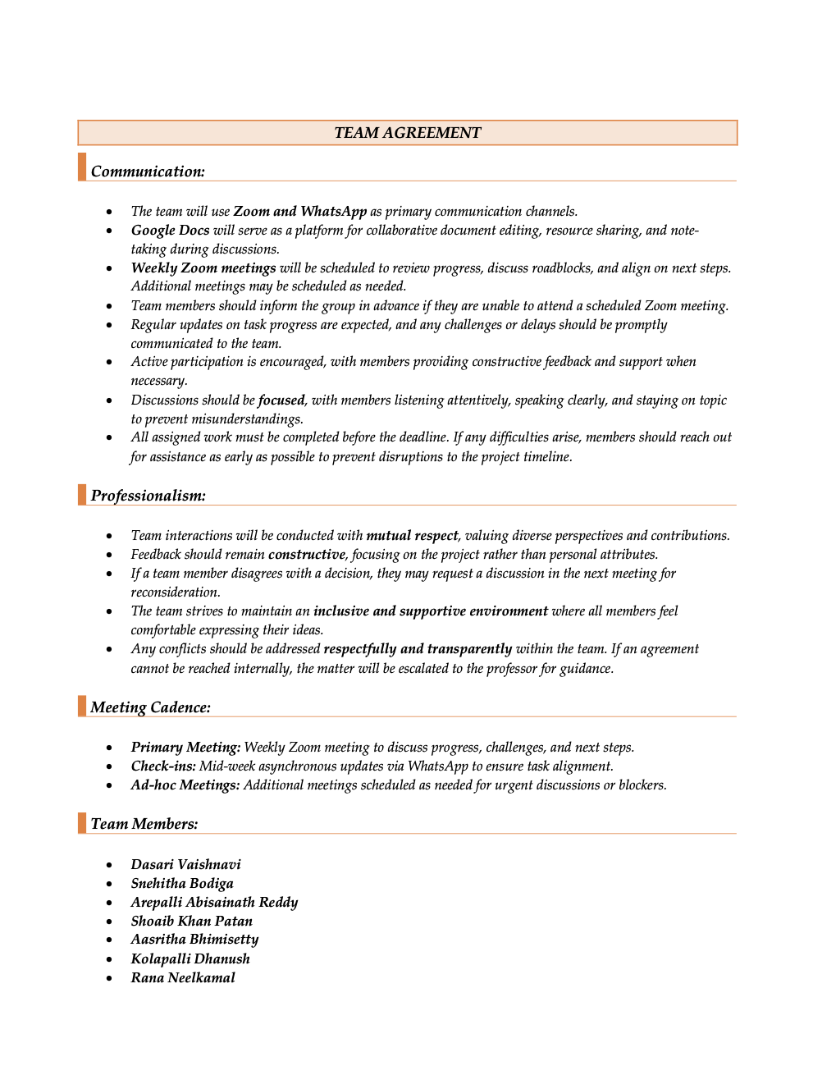
Team Agreement

Slide 9
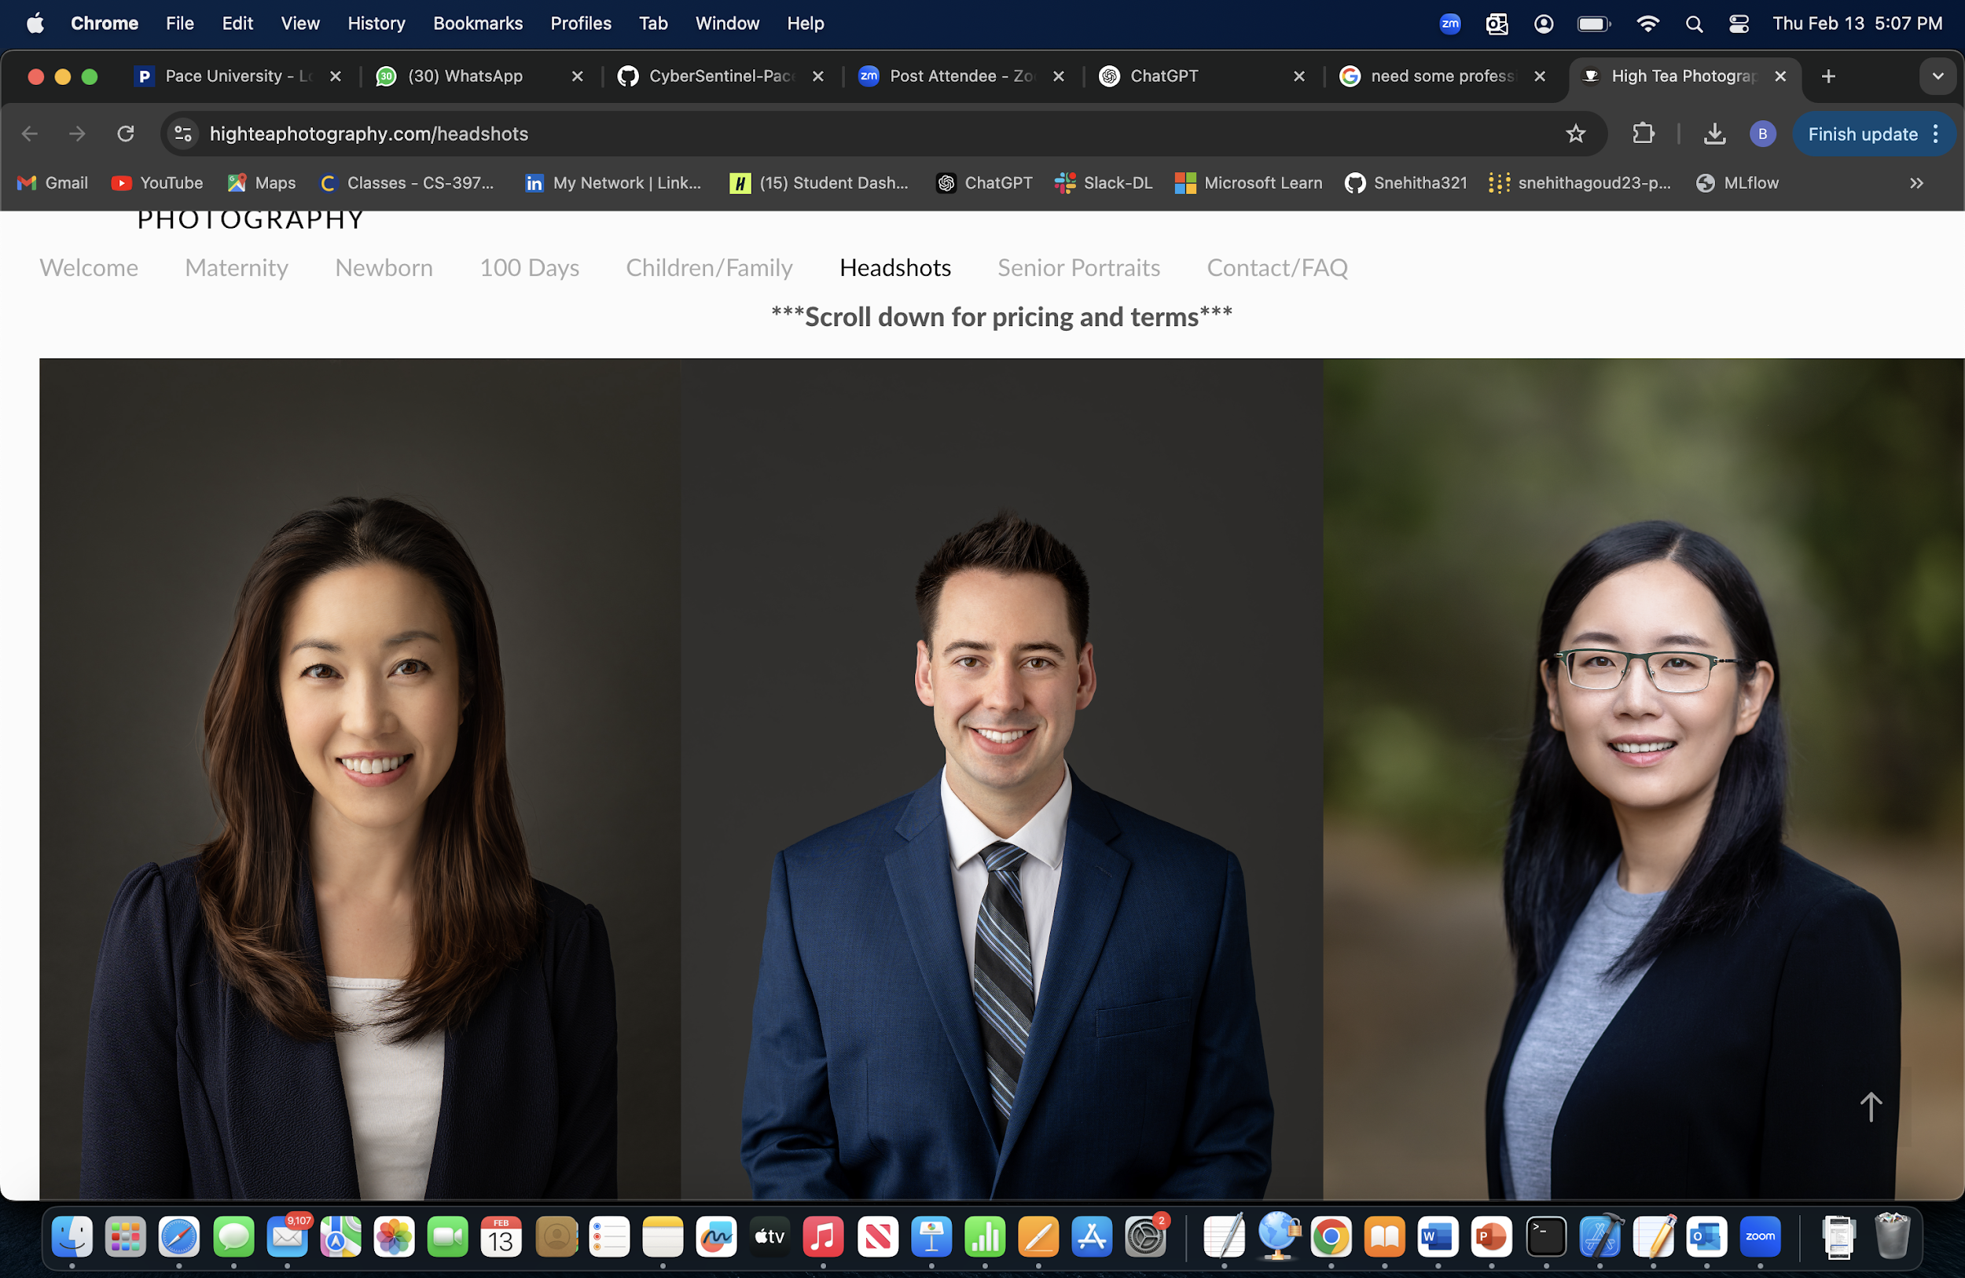
Persona
Alex works at a mid-sized tech company and is well-versed in various technologies. Spends considerable time online, both professionally and personally. Aware of cybersecurity threats but seeks advanced tools to enhance personal security.
Goals:
Protect personal and professional data from phishing and other cyber threats.
Stay informed about the latest cybersecurity practices.
Utilize AI-driven solutions for proactive threat detection.
Challenges:
Balancing convenience with robust security measures.
Identifying trustworthy cybersecurity tools amidst numerous options.
Name: Alex Johnson
Age: 32
Occupation: Software Developer

Slide 10
Persona
Manages a team remotely for a marketing firm. Juggles professional responsibilities with parenting two teenagers. Uses multiple devices for work and personal tasks.
Goals:
- Ensure the security of sensitive work-related information.
- Protect family members, especially children, from online threats.
- Maintain a secure digital environment across all devices.
Challenges:
- Limited time to manage and monitor cybersecurity measures.
- Keeping up with evolving cyber threats and ensuring family compliance with best practices.
Name: Maria Thompson
Age: 40
Occupation: Project Manager

Slide 11
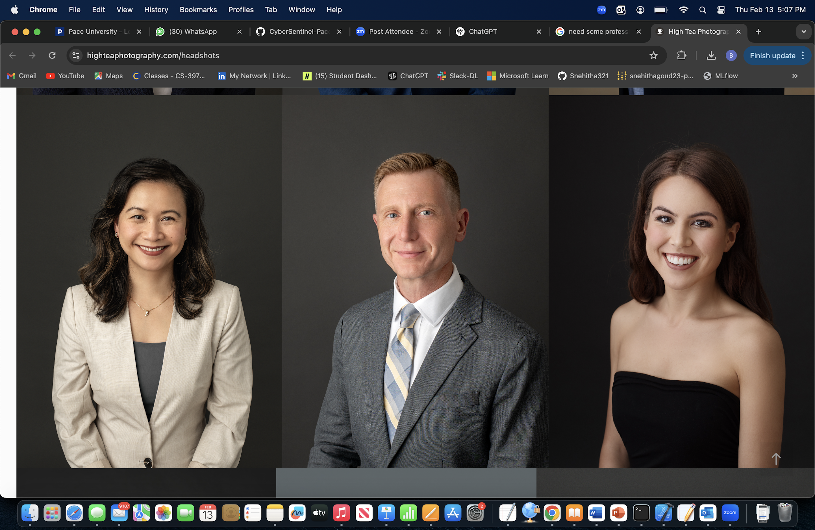
Persona
Runs an online storefront in addition to the physical store. Handles customer data, including payment information. Has basic knowledge of cybersecurity but lacks specialized expertise.
Goals:
- Protect customer data to maintain trust and comply with regulations.
- Prevent financial losses due to cyber attacks.
- Implement cost-effective security solutions without extensive technical knowledge.
Challenges:
- Limited budget for cybersecurity investments.
- Difficulty in assessing which security measures are necessary and effective.
Name: David Kim
Age: 45
Occupation: Owner of a local retail store

Slide 12
Minimum Viable Product (MVP)
Phishing Email Detection Uses NLP models trained on cybersecurity datasets to classify emails as safe or phishing. Helps prevent social engineering attacks by identifying malicious content in real-time.
Fraudulent Transaction Detection Applies anomaly detection techniques to flag suspicious financial transactions. This component supports real-time monitoring for enterprise-level financial systems.
URL Classification Analyzes lexical features of URLs to determine if a web link is malicious or safe. Provides an added layer of protection against phishing websites and drive-by downloads.
User Dashboard A centralized interface that displays alerts, threat levels, and risk analysis in real-time. It allows users to monitor cybersecurity threats and take quick preventive action.

Slide 13




Technologies – Development Stack
Frontend: React.js (for simple and interactive UI)
Backend: Flask (lightweight Python-based API)
Database: PostgreSQL (to store detected threat data)
Hosting: AWS (for cloud deployment and scalability)

Slide 14



Technologies - AI & Cybersecurity Tools
Machine Learning: Scikit-learn, PyTorch (for phishing and fraud detection)
Security: OAuth 2.0 (for authentication), OpenCV (for URL analysis)
Threat Detection Models: NLP-based phishing email classification, anomaly detection for fraudulent transactions, and URL classification algorithms

Slide 15
Algorithms
Phishing Email Detection:
Algorithm: BERT (Bidirectional Encoder Representations from Transformers)
Utilizes a pre-trained deep learning model for text classification.
Captures contextual meaning of words, improving phishing email detection.
Fine-tuned on phishing email datasets for high accuracy.
Fraudulent Transaction Detection:
Algorithm: Autoencoder with Isolation Forest
Autoencoder reduces dimensionality and extracts essential transaction features.
Isolation Forest detects anomalies based on learned representations.
Efficient for unsupervised learning, detecting fraud without requiring labeled data.
URL Classification:
Algorithm: CNN + LSTM (Convolutional Neural Network + Long Short-Term Memory)
CNN extracts spatial features from URL structure.
LSTM captures sequential patterns, improving detection of phishing URLs.
Hybrid deep learning model for better performance over traditional classifiers.

Slide 16
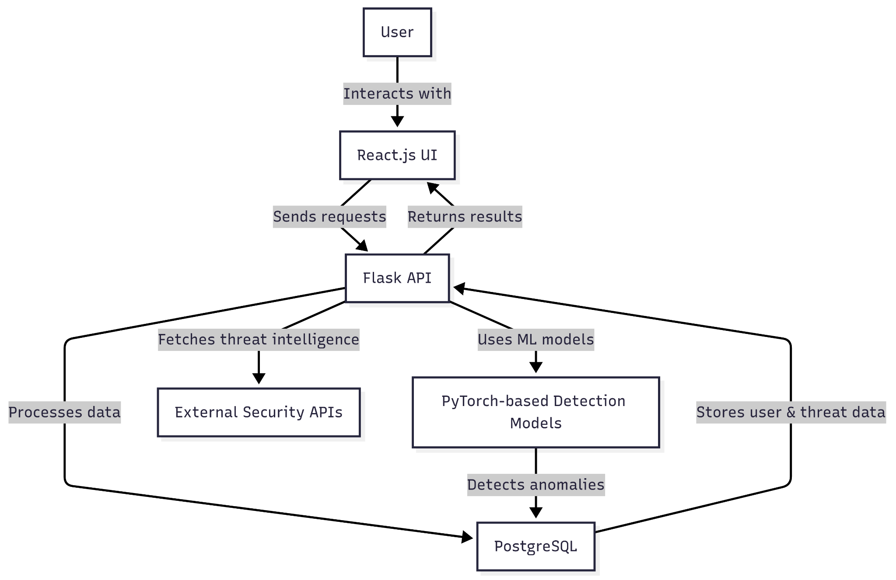
Architecture Diagram

Slide 17
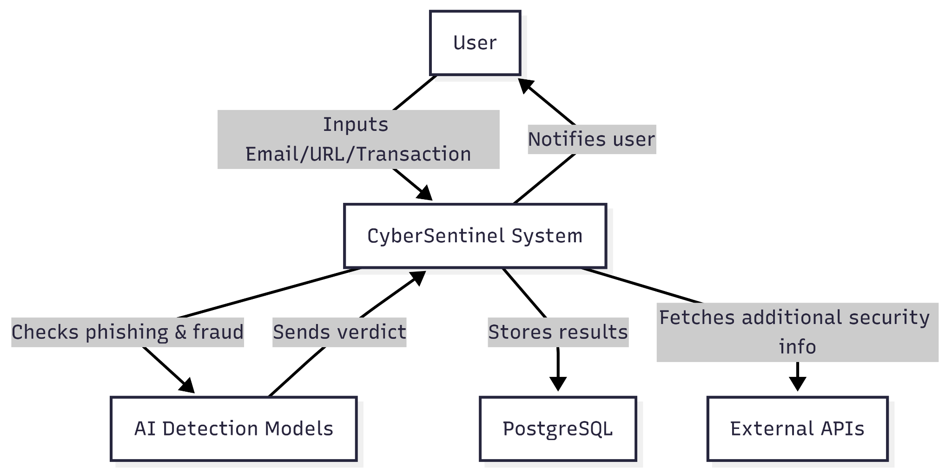
Context Diagram

Slide 18
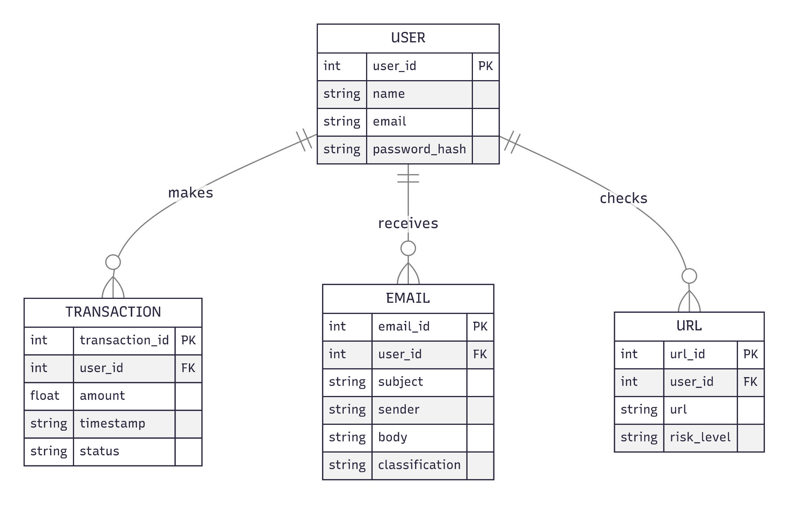
ER Diagram

Slide 19
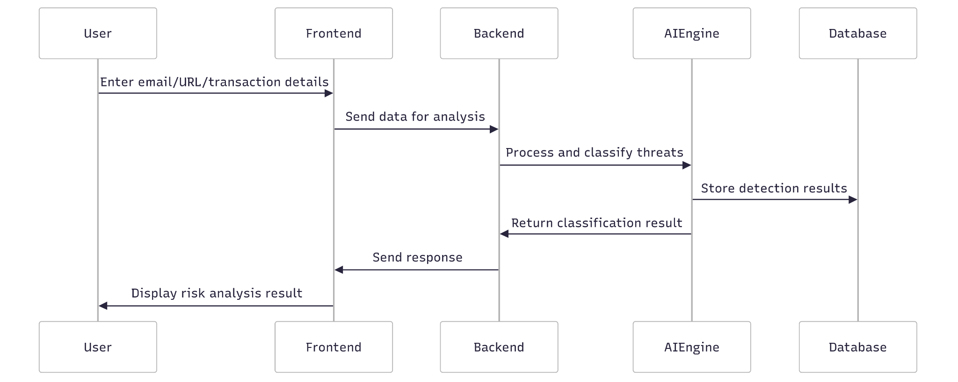
Sequence Diagram

Slide 20
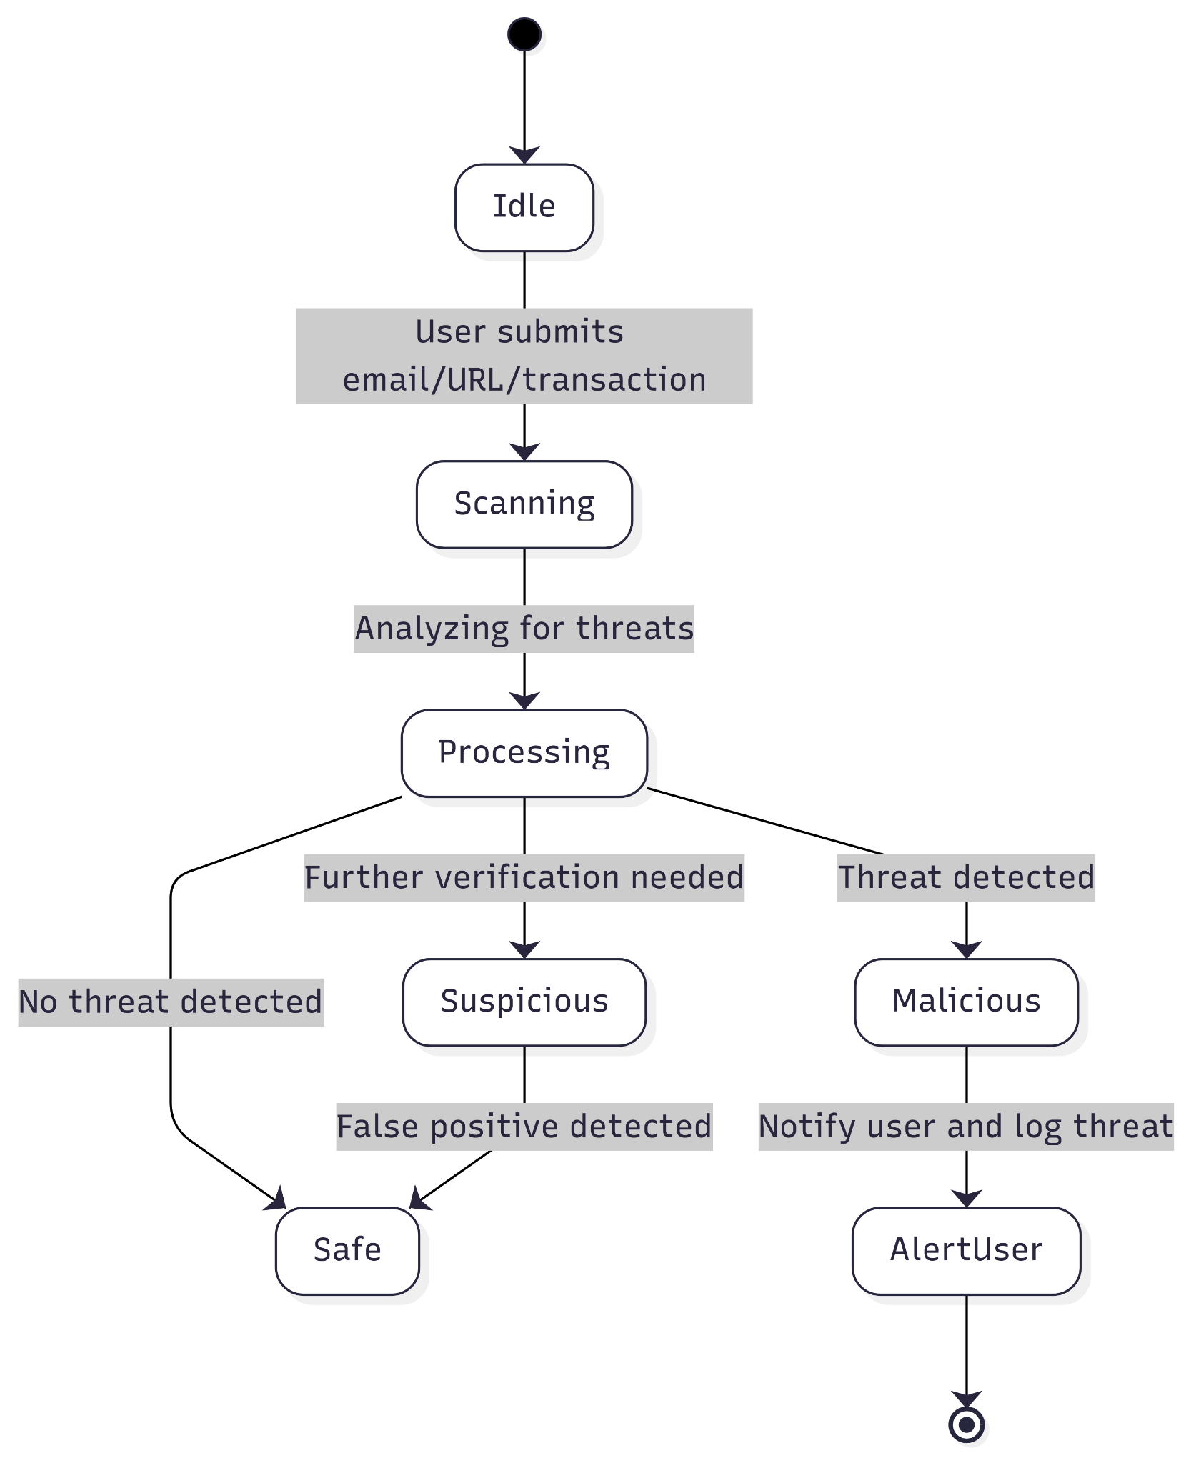
Flow
Diagram

Slide 21
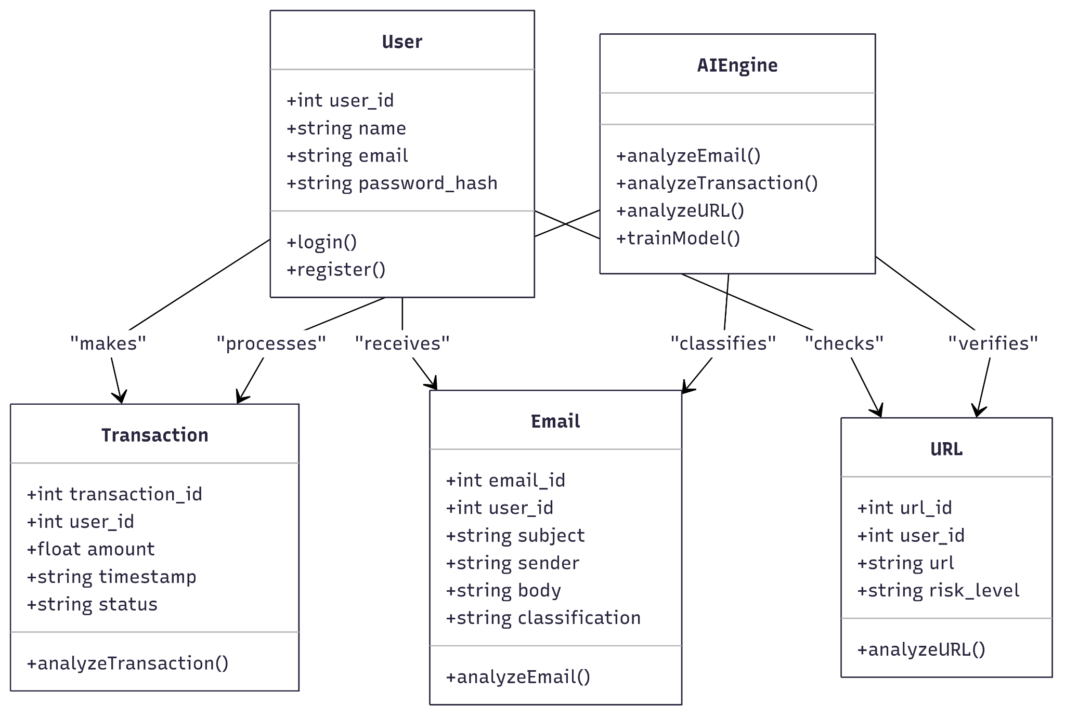
Class Diagram

Slide 22
Sprint 2 Recap
In Sprint 2, the team successfully completed 7 user and technical stories, delivering a total of 63 story points. Key achievements included implementing phishing detection via email upload, transaction fraud detection, malicious URL checks, and sender verification. Technical implementations like integrating the BERT model for phishing, deploying CNN+LSTM for URL classification, and using Autoencoder + Isolation Forest for fraud detection were also completed. However, two stories—user role management (US_04) and OAuth authentication (TS_03)—were not completed, accounting for 13 story points. Overall, the sprint demonstrated strong progress in core detection features, despite minor backlog carryovers to Sprint 3.

Slide 23
Product Backlog - User Stories
ID | User Story | Acceptance Criteria | Sprint | Story Points
US_01 | As someone monitoring threats, I want a dashboard to view phishing email history so that I can track past threats. | Dashboard displays list of phishing emails with filtering options. | Sprint 1 | 5
US_02 | As an email recipient, I want to filter emails based on risk level so that I can quickly identify dangerous emails. | System allows filtering by safe, suspicious, and phishing categories. | Sprint 1 | 3
US_03 | As a security admin, I want to view statistics on detected threats so that I can analyze system performance. | Dashboard provides statistics on phishing, fraud, and malicious URLs. | Sprint 1 | 8
US_04 | As a platform administrator, I want to manage user roles and permissions so that I can control access levels. | System supports different access levels for users and admins. | Sprint 1 | 8
US_05 | As an individual reviewing suspicious emails, I want to upload an email for phishing detection so that I can know if it's safe. | System classifies email as safe, suspicious, or phishing with an alert. | Sprint 2 | 8

Slide 24
Product Backlog - User Stories
ID | User Story | Acceptance Criteria | Sprint | Story Points
US_06 | As a finance manager, I want to upload transaction data so that I can detect fraudulent activities. | System flags transaction as normal or suspicious with a confidence score. | Sprint 2 | 13
US_07 | As someone browsing the web, I want to check if a URL is malicious so that I can avoid phishing sites. | System checks URL structure and domain reputation, classifying it as safe, suspicious, or malicious. | Sprint 2 | 5
US_08 | As a cautious email reader, I want to verify if a sender email is trustworthy so that I can decide whether to engage with the sender. | System checks sender reputation and displays a trust score. | Sprint 2 | 8
US_09 | As a system user, I want to receive real-time alerts for detected threats so that I can take immediate action. | User receives notifications via email or app for detected threats. | Sprint 3 | 8
US_10 | As a user of the detection system, I want an option to report a false positive classification so that I can help improve detection accuracy. | Users can flag an incorrect detection for review. | Sprint 3 | 3

Slide 25
Product Backlog - Technical Stories
ID | Technical Story | Acceptance Criteria | Sprint | Story Points
TS_01 | Create a dashboard for threat statistics so that admins can monitor system performance. | Dashboard displays data on detected threats. | Sprint 1 | 8
TS_02 | Design a user role management system so that access levels can be controlled efficiently. | Admins can assign permissions to different user roles. | Sprint 1 | 8
TS_03 | Implement OAuth authentication for secure user access so that users can log in securely. | User authentication is secure, and access tokens work correctly. | Sprint 1 | 5
TS_04 | Set up AWS for cloud deployment so that the system can be scalable and accessible. | Backend deployed and accessible via API. | Sprint 1 | 5
TS_05 | Integrate BERT model for phishing email detection so that emails can be classified accurately. | Model achieves at least 90% accuracy on test data. | Sprint 2 | 8

Slide 26
Product Backlog - Technical Stories
ID | Technical Story | Acceptance Criteria | Sprint | Story Points
TS_06 | Implement Autoencoder + Isolation Forest for fraud detection so that anomalies in transactions can be detected. | Model correctly classifies anomalies in dataset. | Sprint 2 | 13
TS_07 | Deploy CNN + LSTM model for URL detection so that phishing websites can be identified. | Model classifies URLs with at least 85% accuracy. | Sprint 2 | 8
TS_08 | Implement email sender verification model so that sender reputation can be assessed. | System provides a sender trust score based on reputation. | Sprint 2 | 5
TS_09 | Develop a notification system for real-time alerts so that users are informed of potential threats. | Users receive accurate notifications for detected threats. | Sprint 3 | 8
TS_10 | Develop a feedback mechanism for false positive reports so that the system can improve over time. | Users can flag and submit incorrect classifications for review. | Sprint 3 | 3

Slide 27
Sprint 1 Summary
Sprint 1 established the foundation for the detection platform by delivering 6 out of 8 planned stories, totaling 37 story points. Major accomplishments included dashboard creation, threat statistics, user role setup, and AWS deployment. Two stories—OAuth login and role permissions—were not completed and were carried forward to Sprint 2.
Category | Count | Story Points
Stories Completed | 6 | 37
Stories Not Completed | 2 | 13
Total | 8 | 50

Slide 28
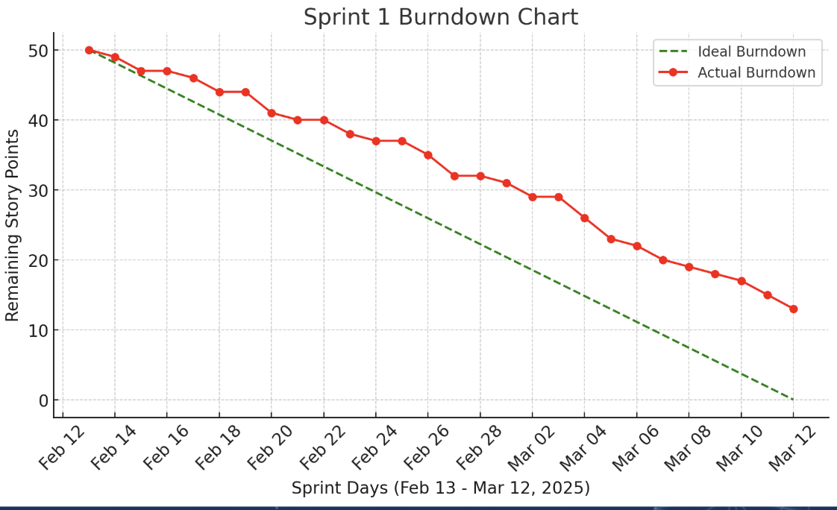
Sprint 1 Burndown

Slide 29
Sprint 2 Summary
Sprint 2 focused on enhancing detection capabilities across emails, transactions, and URLs. The team completed 7 out of 9 stories, totaling 63 points. Two stories—OAuth and user roles—were carried forward. Core ML models were integrated successfully, strengthening the platform's threat identification capabilities and setting the stage for Sprint 3.
Category | Count | Story Points
Stories Completed | 7 | 63
Stories Not Completed | 2 | 13
Total | 9 | 76

Slide 30
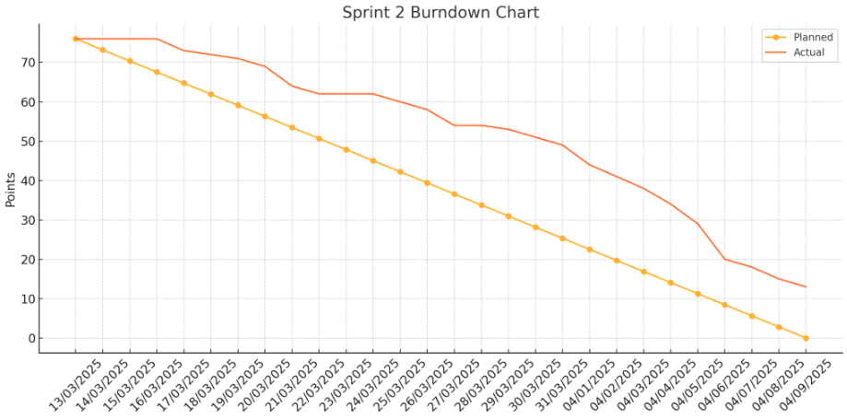
Sprint 2 Burndown

Slide 31
Sprint 3 Backlog
ID | User Story | Acceptance Criteria | Story Points
US_09 | As a system user, I want to receive real-time alerts for detected threats so that I can take immediate action. | User receives notifications via email or app for detected threats. | 8
US_10 | As a user of the detection system, I want an option to report a false positive classification so that I can help improve detection accuracy. | Users can flag an incorrect detection for review. | 3
TS_09 | Develop a notification system for real-time alerts so that users are informed of potential threats. | Users receive accurate notifications for detected threats. | 8
TS_10 | Develop a feedback mechanism for false positive reports so that the system can improve over time. | Users can flag and submit incorrect classifications for review. | 3
US_04 (Carry forward) | As a platform administrator, I want to manage user roles and permissions so that I can control access levels. | System supports different access levels for users and admins. | 8
TS_03 (Carry forward) | Implement OAuth authentication for secure user access so that users can log in securely. | User authentication is secure, and access tokens work correctly. | 5

Slide 32
Test Cases Sprint 3
Test Case ID | Story ID | Test Case | Expected Outcome | Actual Outcome | Pass/Fail
TC_01 | US_09 | Trigger a phishing detection and observe notification behavior. | User receives real-time alert via email or app. | Notification received instantly via both email and app. | Pass
TC_02 | US_10 | Report a phishing email wrongly classified as phishing (false positive). | Detection is flagged for review; confirmation shown to user. | False positive report submitted successfully and confirmation displayed. | Pass
TC_03 | TS_09 | Simulate threat and test real-time alert system. | Accurate alert notification is delivered promptly. | Alert sent with correct threat info within seconds of detection. | Pass
TC_04 | TS_10 | Submit feedback for a false positive case. | System logs the feedback and confirms successful submission. | Feedback recorded and user notified of successful submission. | Pass
TC_05 | US_04 | Assign different roles (admin/user) and test access control. | System applies roles correctly and restricts access accordingly. | Admin and user roles assigned successfully; access restrictions in place. | Pass

Slide 33
Test Cases Sprint 3
Test Case ID | Story ID | Test Case | Expected Outcome | Actual Outcome | Pass/Fail
TC_06 | TS_03 | Login with valid OAuth credentials. | User receives access token and logs in securely. | Successful login and valid token generated. | Pass
TC_07 | TS_03 | Login with invalid OAuth credentials. | Login fails with appropriate error message. | Login attempt blocked; error message shown correctly. | Pass

Slide 34
Sprint 3 Stories Completed
ID | User Story / Task | Story Points
US_09 | As a system user, I want to receive real-time alerts for detected threats | 8
US_10 | As a user of the detection system, I want an option to report a false positive classification | 3
TS_09 | Develop a notification system for real-time alerts | 8
TS_10 | Develop a feedback mechanism for false positive reports | 3
US_04 | As a platform administrator, I want to manage user roles and permissions | 8
TS_03 | Implement OAuth authentication for secure user access | 5

Slide 35
Team Velocity
Total Story Points Completed: 35

Slide 36
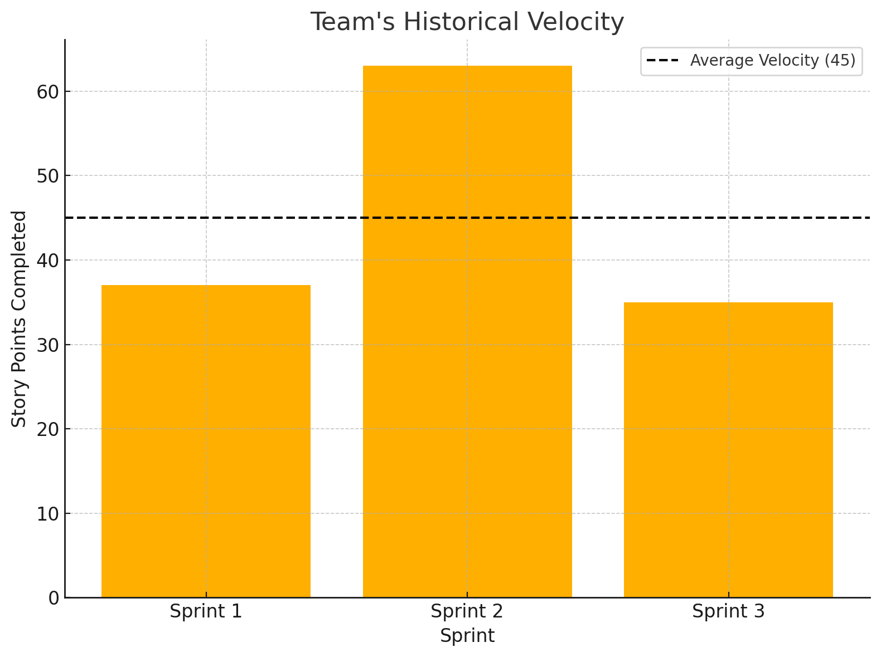
Team's Historical Velocity
Sprint 1 Velocity: 37 story points
Sprint 2 Velocity: 63 story points
Sprint 3 Velocity: 35 story points
Average Velocity: (37 + 63 + 35) / 3 = 40 story points

Slide 37
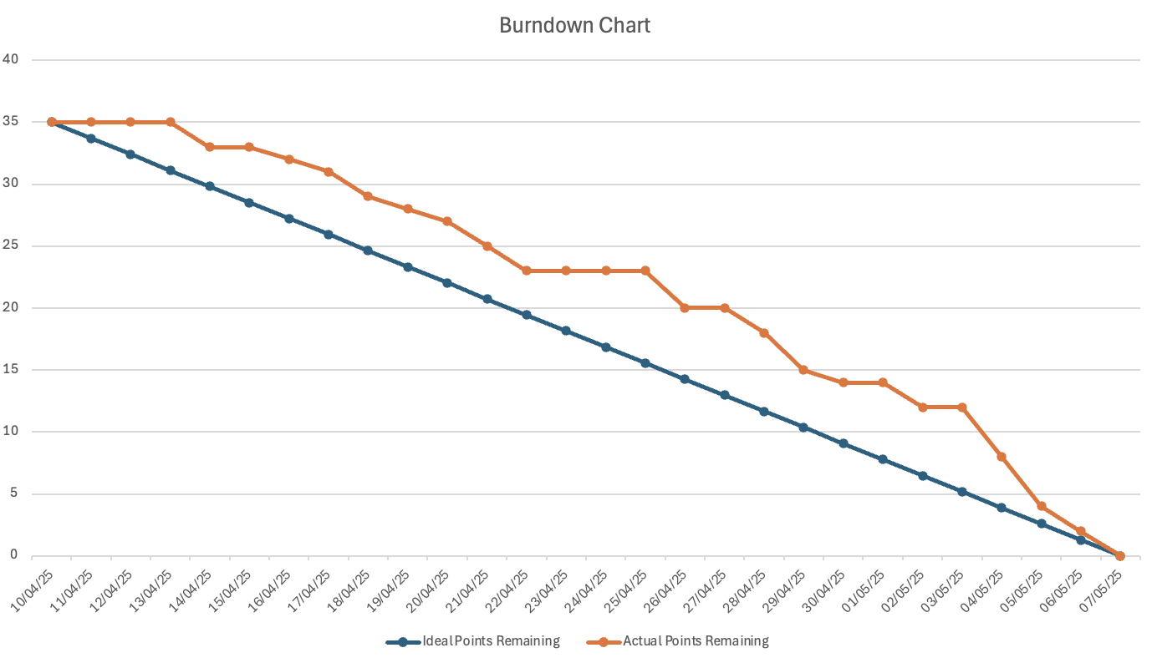
Burn Down Chart

Slide 38
Completed/Committed Ratio
74%
84.8%
86.26%
100%
Sprint 2
Sprint 3
Average Ratio
Sprint 1

Slide 39
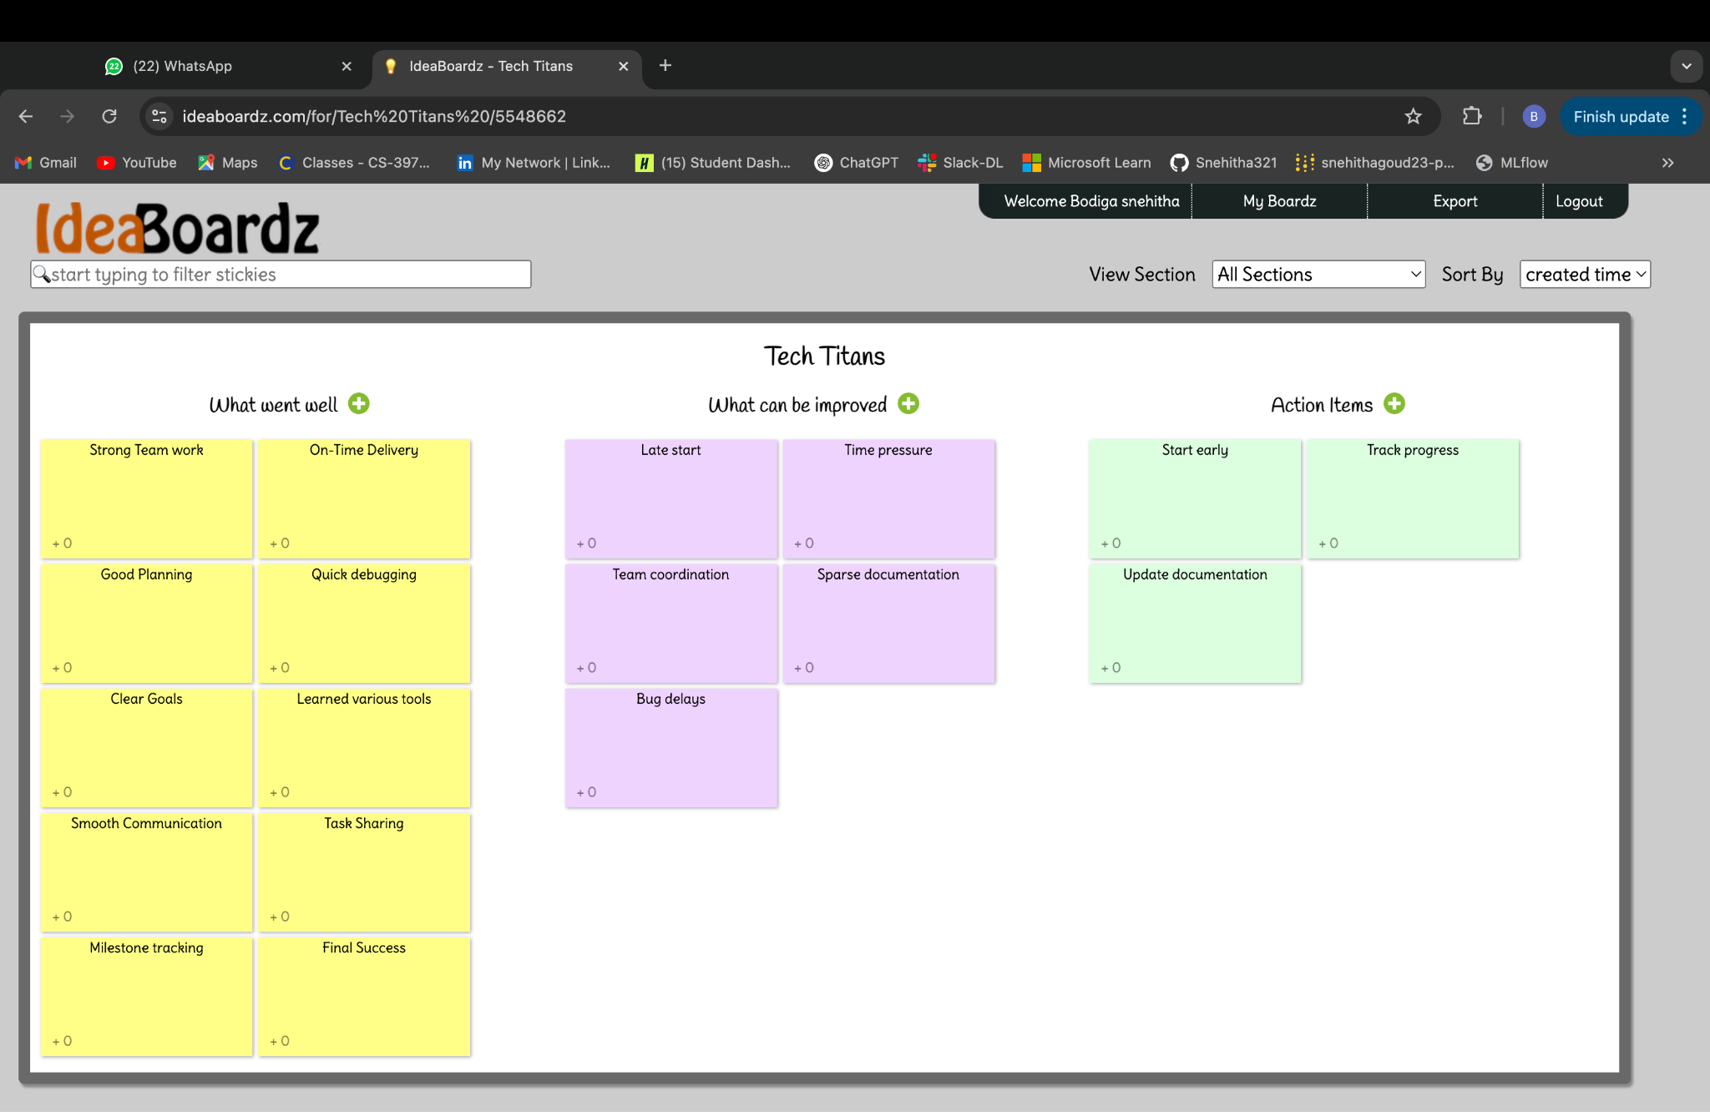
Retrospective

Slide 40
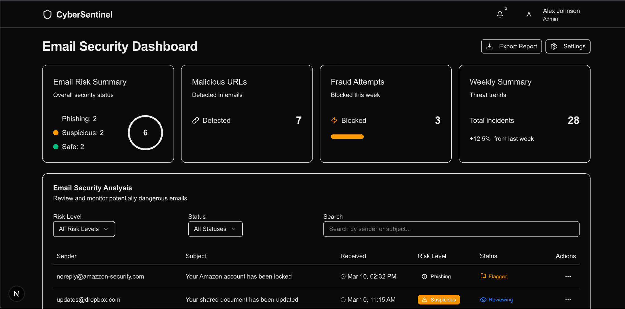
Application Screenshots

Slide 41
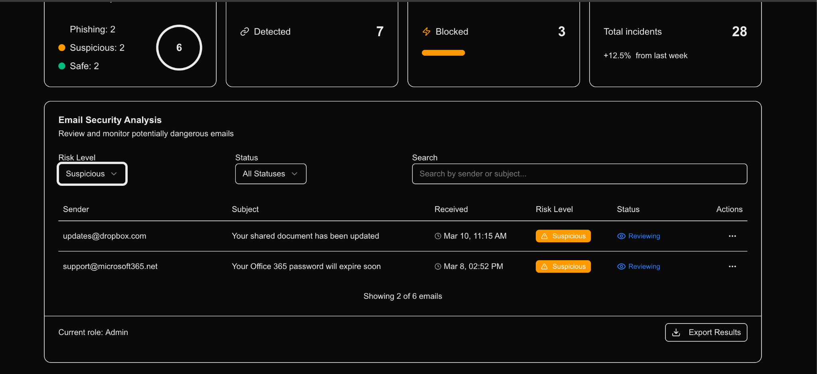
Application Screenshots

Slide 42
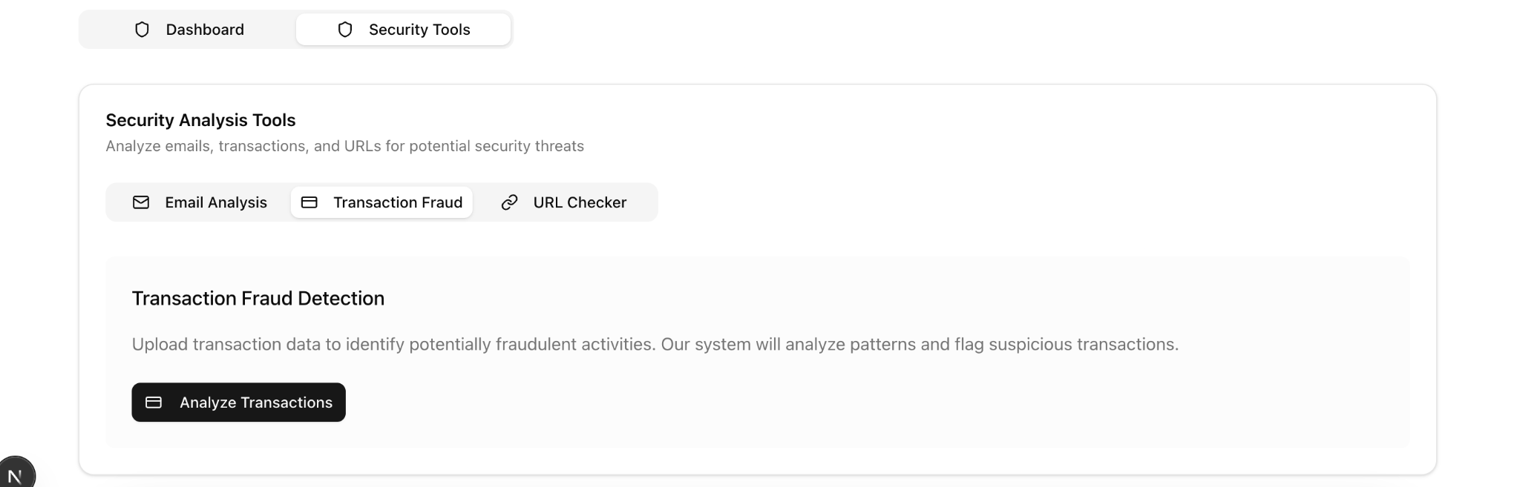
Application Screenshots

Slide 43
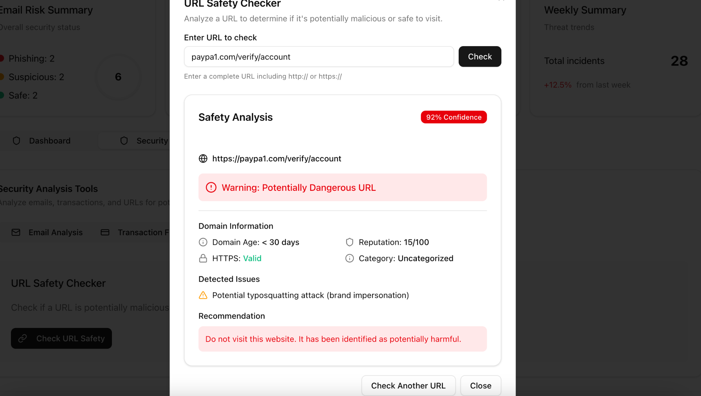
Application Screenshots

Slide 44
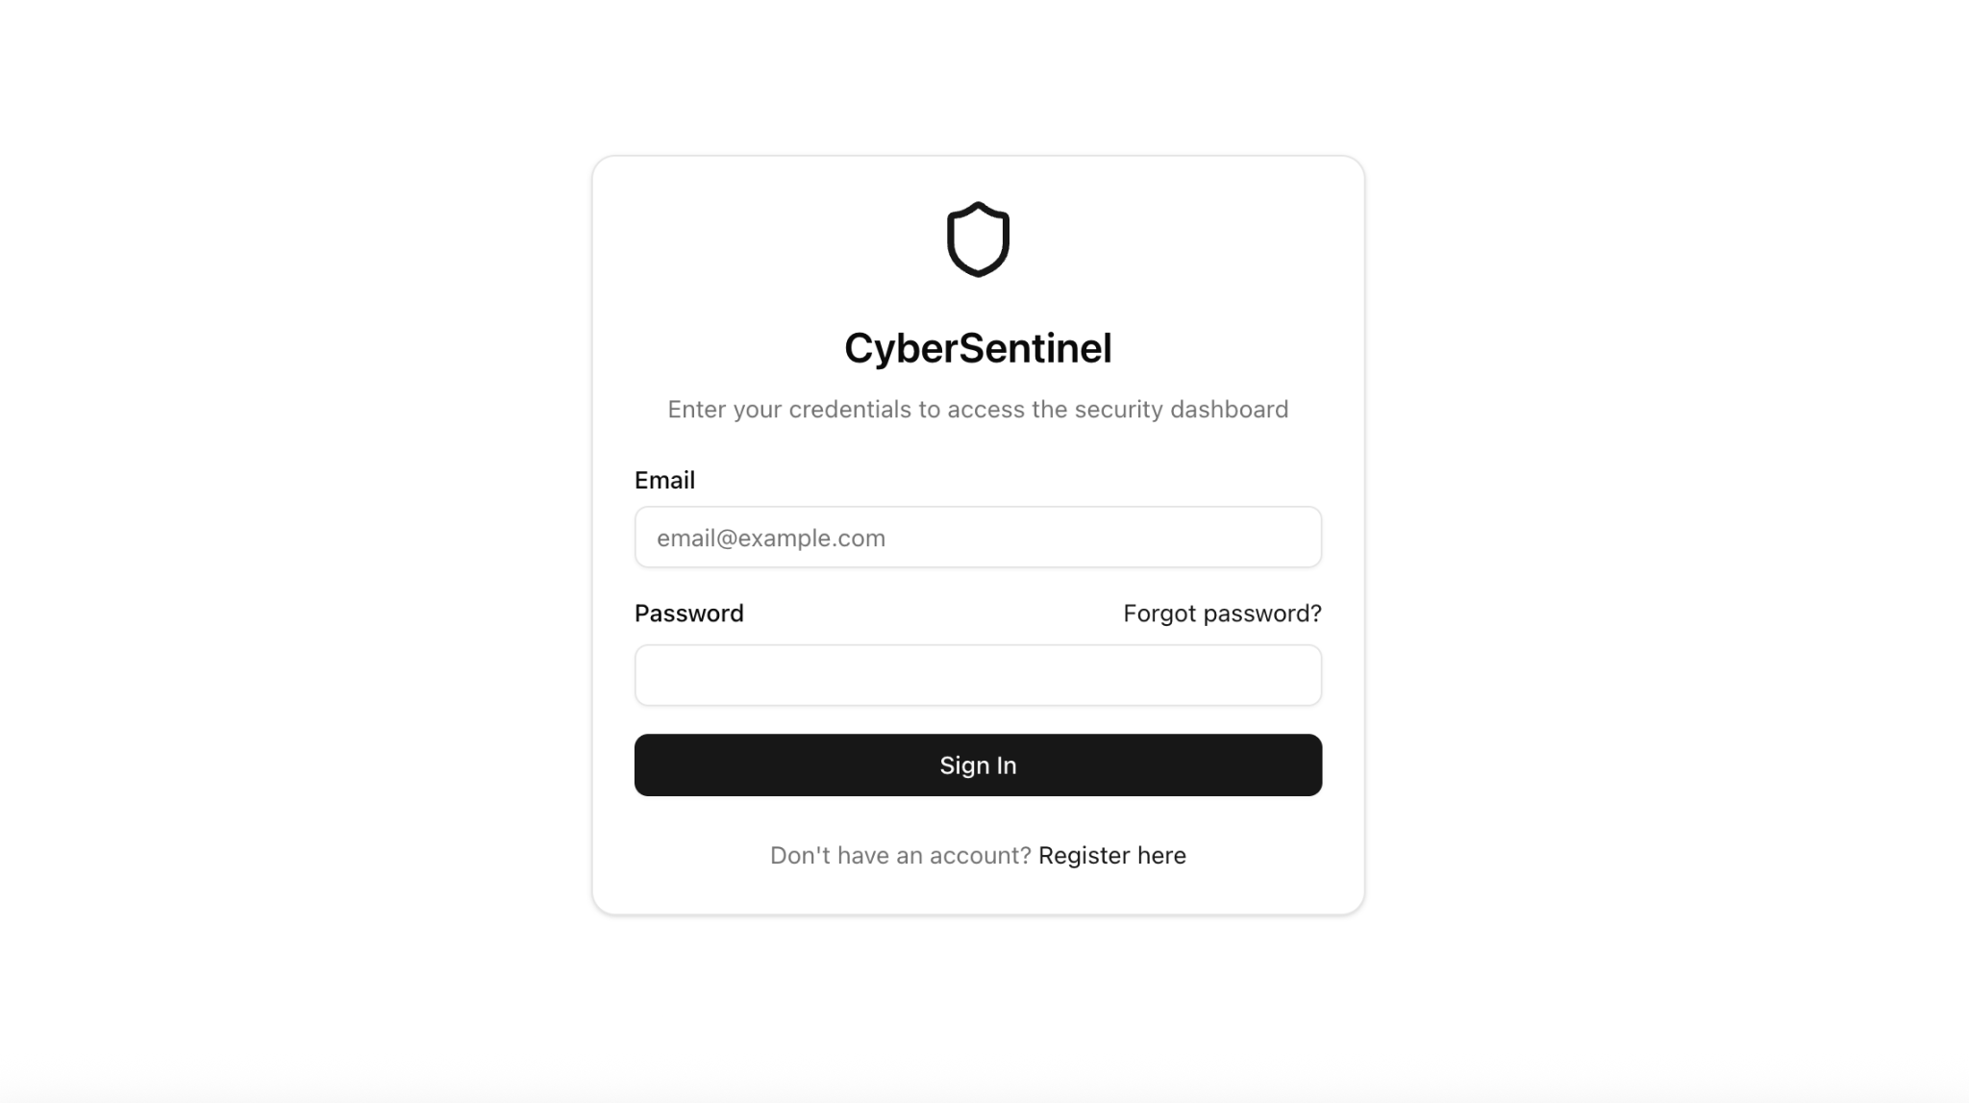
Application Screenshots

Slide 45
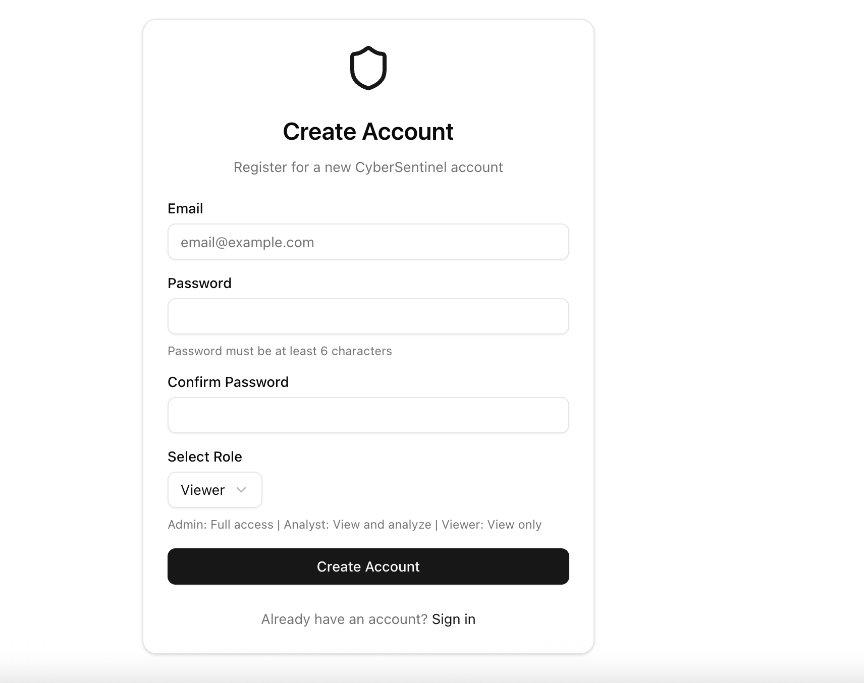
Application Screenshots

Slide 46
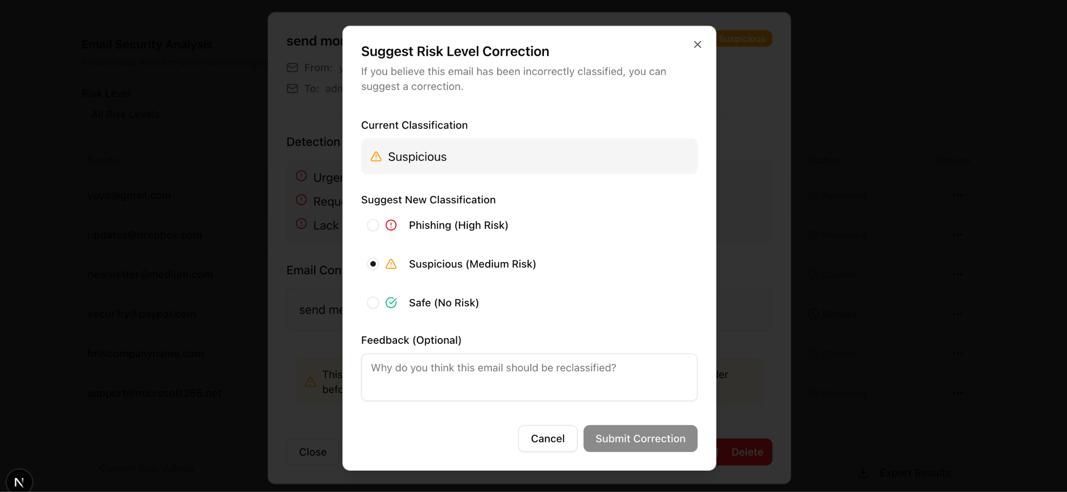
Application Screenshots

Slide 47
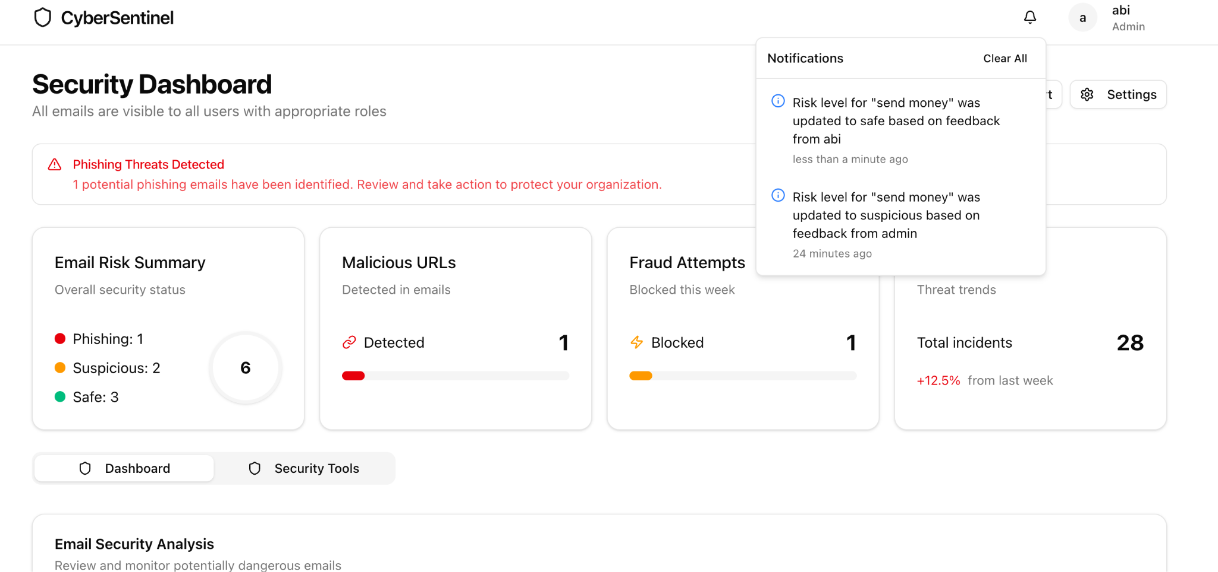
Application Screenshots

Slide 48
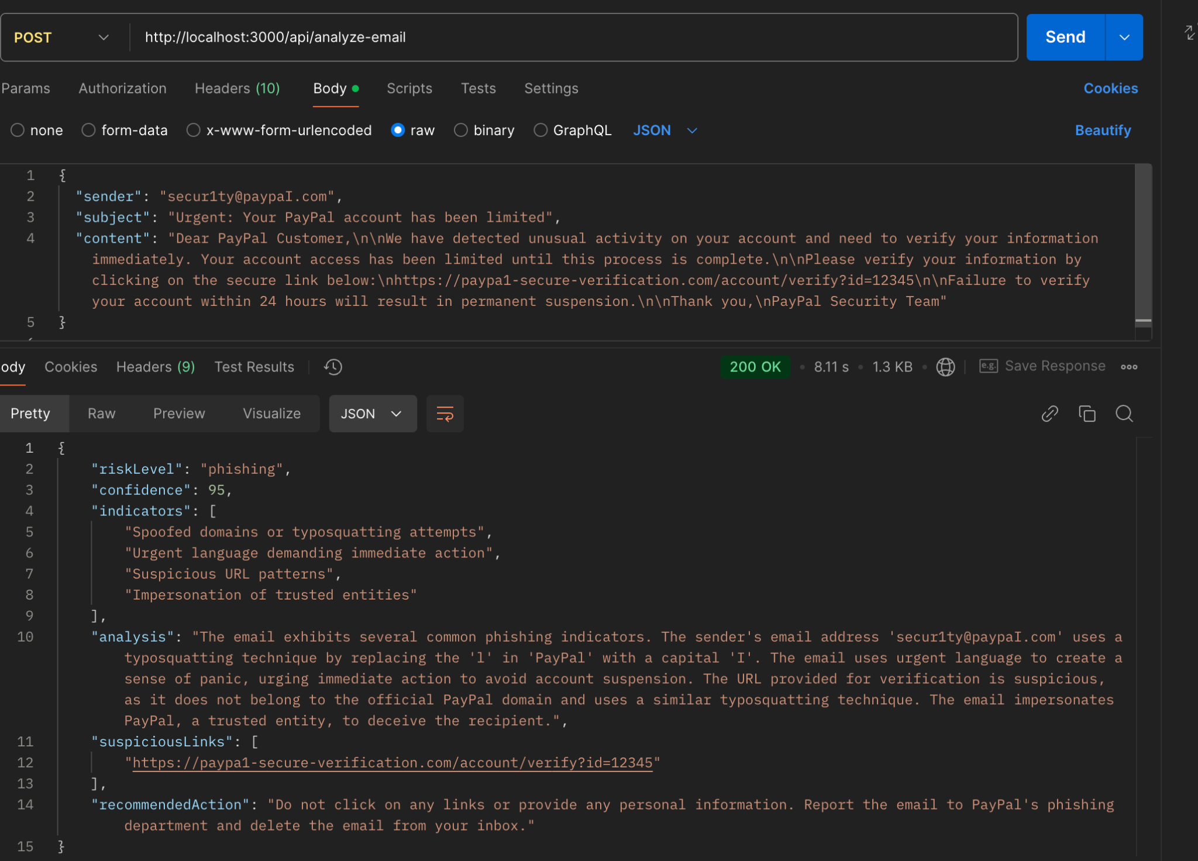
API Screenshots

Slide 49
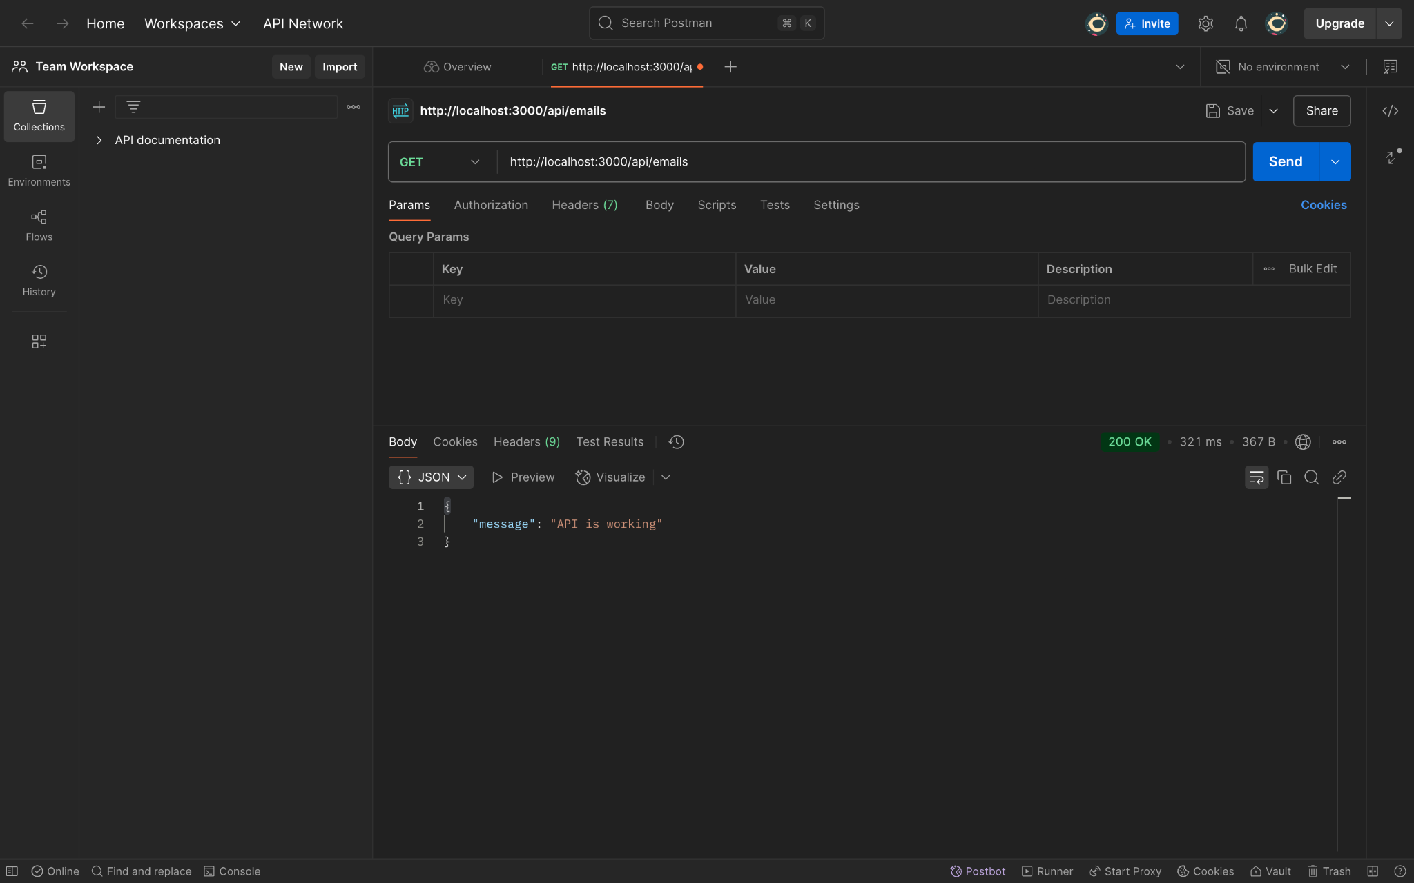
API Screenshots

Slide 50
Github Wikipage Link
https://github.com/htmw/2025S-Tech-Titans/wiki

Slide 51
Application Demo

Slide 52


